Slide 1
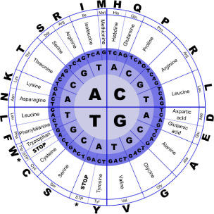
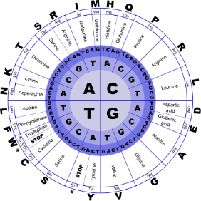


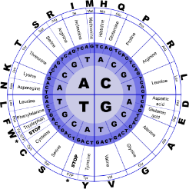
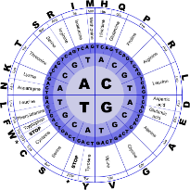
Fundamentals of Programming II
Exceptions

Slide 2
Exceptions
An exception is a value or an object that indicates that an error has occurred
When an exception occurs, the program must either terminate or jump to special code for handling the exception.
The special code for handling the exception is called an exception handler

Slide 3
Exceptions
throw – followed by an argument, is used to signal an exception
try – followed by a block { }, is used to invoke code that throws an exception
catch – followed by a block { }, is used to process exceptions thrown in a preceding try block. It takes a parameter that matches the type of exception thrown

Slide 4
Throwing an Exception
Code that detects the exception must pass information to the exception handler. This is done using a throw statement:
throw "Emergency!"
throw 12;
In C++, information thrown by the throw statement may be a value of any type

Slide 5
Catching an Exception
Block of code that handles the exception is said to catch the exception and is called an exception handler
An exception handler is written to catch exceptions of a given type: For example, the code
catch(char *str)
{
cout << str;
}
can only catch exceptions of type C-string

Slide 6
Catching an Exception
Another example of a handler:
catch(int x)
{
cerr << "Error: " << x;
}
This can catch exceptions of type int

Slide 7
Connecting to the Handler
Every catch block is attached to a try block of code and is responsible for handling exceptions thrown from that block
try
{
}
catch(char e1)
{
// This code handles exceptions
// of type char that are thrown
// in this block
}

Slide 8
Connecting to the Handler
int main( )
{
try
{
double x;
cout << "Enter a number: ";
cin >> x;
if (x < 0) throw "Bad argument!";
cout << "Square root of " << x << " is " << sqrt(x);
}
catch(char *str)
{
cout << str;
}
return 0;
}

Slide 9
Flow of Control
Computer encounters a throw statement in a try block
The computer evaluates the throw expression, and immediately exits the try block
The computer selects an attached catch block that matches the type of the thrown value, places the value in the catch block’s formal parameter, and executes the catch block

